Slide 1







Borcelle
Smart Hospital
Management System (OOP Project)
Get Started

Slide 2




# Case Study
Case Study Statement — Hospital Management System
You are developing a Hospital Management System designed to automate and streamline the day-to-day operations of a hospital. The system focuses on managing various types of users — Patients, Doctors, Nurses, and Admins — and automating key hospital processes such as appointments, prescriptions, medical records, and room management. It serves as a centralized platform for hospital administration, ensuring accuracy, efficiency, and better coordination among all departments.
System Functionalities
Patients can register into the system, book appointments with doctors, view their medical records, and access their prescriptions.
Doctors can view and update patient medical histories, manage their scheduled appointments, and issue prescriptions for patients.
Nurses assist doctors by recording patient vitals and helping in patient care and monitoring.
Admins manage all system users, assign rooms to admitted patients, and oversee hospital operations and resources.
Each Appointment links a Patient to a Doctor on a specific date and time, maintaining its status (scheduled, completed, or cancelled).
Each Room belongs to the hospital and can be assigned to a Patient during admission or released once discharged.
A MedicalRecord maintains complete patient health information, treatment history, and doctor notes.
A Prescription contains detailed medicine information, dosage, and duration, and is always linked to both a Doctor and a Patient.

Slide 3






#Classes
Borcelle
User
Doctor
Nurse
Patient
Admin
Appointment
MedicalRecord
Prescription
Learn More
Room
HospitalManagement(Main)

Slide 4





Borcelle
Attributes
User
Doctor
Patient
id : String
name : String
email : String
phone : String
doctorId : String
specialization : String
appointments : ArrayList<Appointment>
writtenPrescriptions : ArrayList<Prescription>
patientId : String
medicalRecord : MedicalRecord
room : Room
appointments : ArrayList<Appointment>
prescriptions : ArrayList<Prescription>

Slide 5



Borcelle
Attributes
Nurse
Admin
Appointment
nurseId : String
assignedPatients : ArrayList<Patient>
adminId : String
appointmentId : String
patient : Patient
doctor : Doctor
dateTime : LocalDateTime
status : String

Slide 6


Borcelle
Attributes
MedicalRecord
Prescription
Room
recordId : String
patient : Patient
history : ArrayList<String>
prescriptionId : String
doctor : Doctor
patient : Patient
medicineName : String
dosage : String
duration : String
issuedAt : LocalDateTime
roomId : String
type : String
occupied : boolean
assignedPatient : Patient

Slide 7

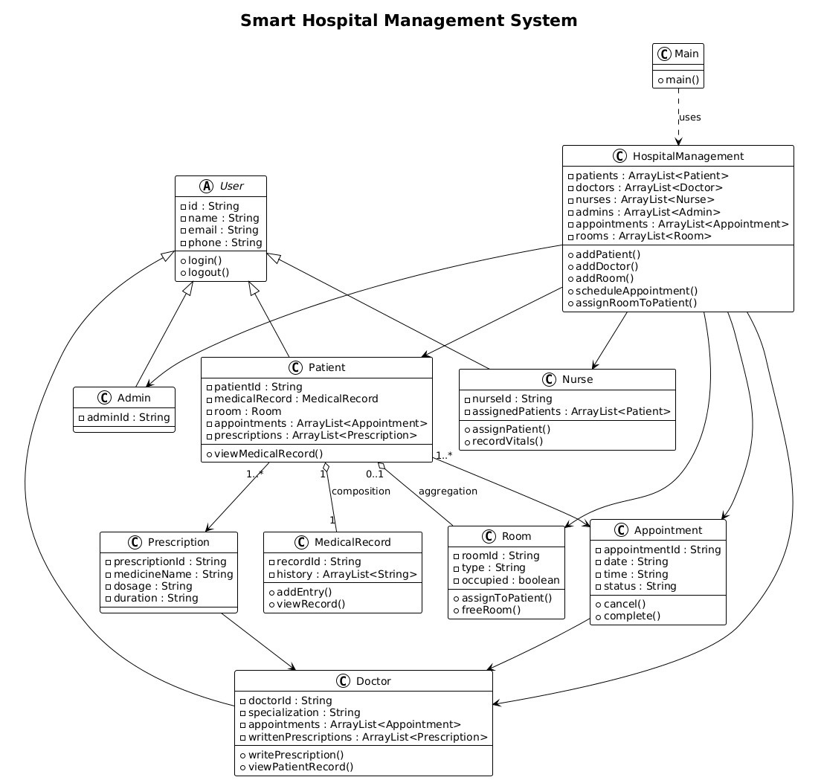


UML Diagram

Slide 8


DELARS
Thank You
for your time and attention
Done by :
Ahmed Hossam
Abdulmalek
Shehap Elbatanouny

